Slide 1
Homelessness in Our Communities Western Massachusetts
Integrated Treatment Services
Trauma-Responsive Homelessness Work
Collaborative Mental Health, Substance Abuse, Medical, and Housing Case Management Programming in Western Massachusetts
Christy O’Brien, MSW, LICSW

Slide 2
Christy O’Brien, LICSW
Friends of the Homeless, Clinical Director; Model and Services
Center for Human Development, Program Director, Community Behavioral Health Center (CBHC), Chicopee

Slide 3
Homelessness In Massachusetts
Homelessness in the United States has been on the rise even prior to the COVID-19 pandemic.
According to the U.S. Department of Housing and Urban Development, 17,975 people in MA experienced homelessness in 2020. (Point in Time Count.)
Between 2007 and 2020, Massachusetts has seen an 18.8% increase in homelessness, the third highest in the nation during this period.
Over 1,200 Massachusetts residents remained unsheltered in 2020.
According to the 2019 MA Youth Count, 25% of youth facing housing insecurity were LGBTQ+ and over 31% were involved in the foster care system.

Slide 4
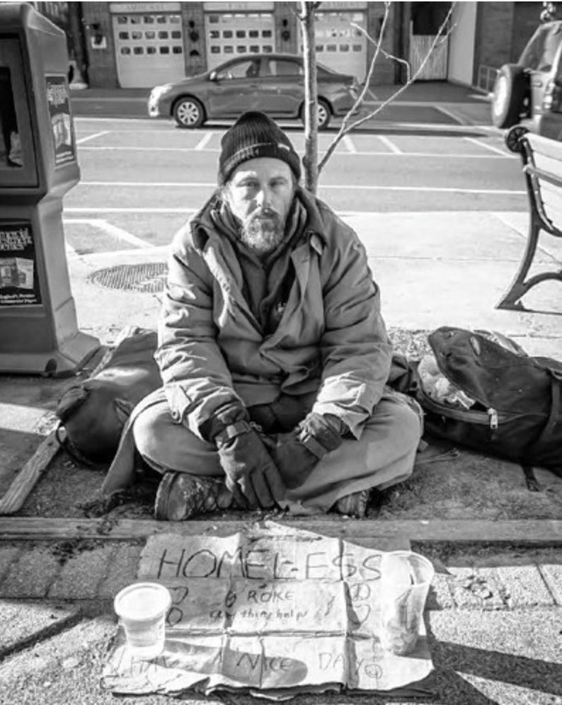
Two Categories: Individual & Family Shelter Systems

Slide 5
Massachusetts: Family Right to Shelter State

Slide 6
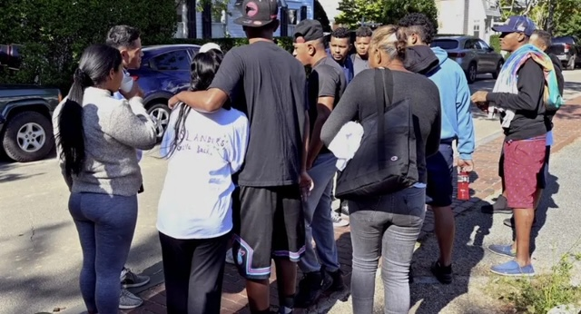
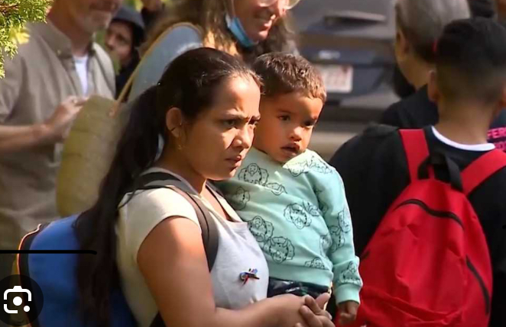
Shelter Crisis
Record-breaking influx of migrant/refugee families
August 2023: Gov. Healy identified funding cap at 7,500 families/23,000+ individuals
October 30, 2023, 7,319 occupied
November 9, 2023 = 0
Governor Maura Healey announced that "the state does not have enough shelter, space, service, providers, or funding to safely expand beyond 7500 families."
Declared state of emergency in August 2023
3,806 families living in hotels and motels, 3,650 at traditional shelter sites, and 61 in temporary locations, according to the data.

Slide 7
What do we do?
Continuum of Care (CoCs)
Hierarchy of housed first
Elderly
Medically Ill
Severely Mentally Ill
Expedite transitional-to-permanent housing
Push systems:
DMH, DDS, DCF

Slide 8
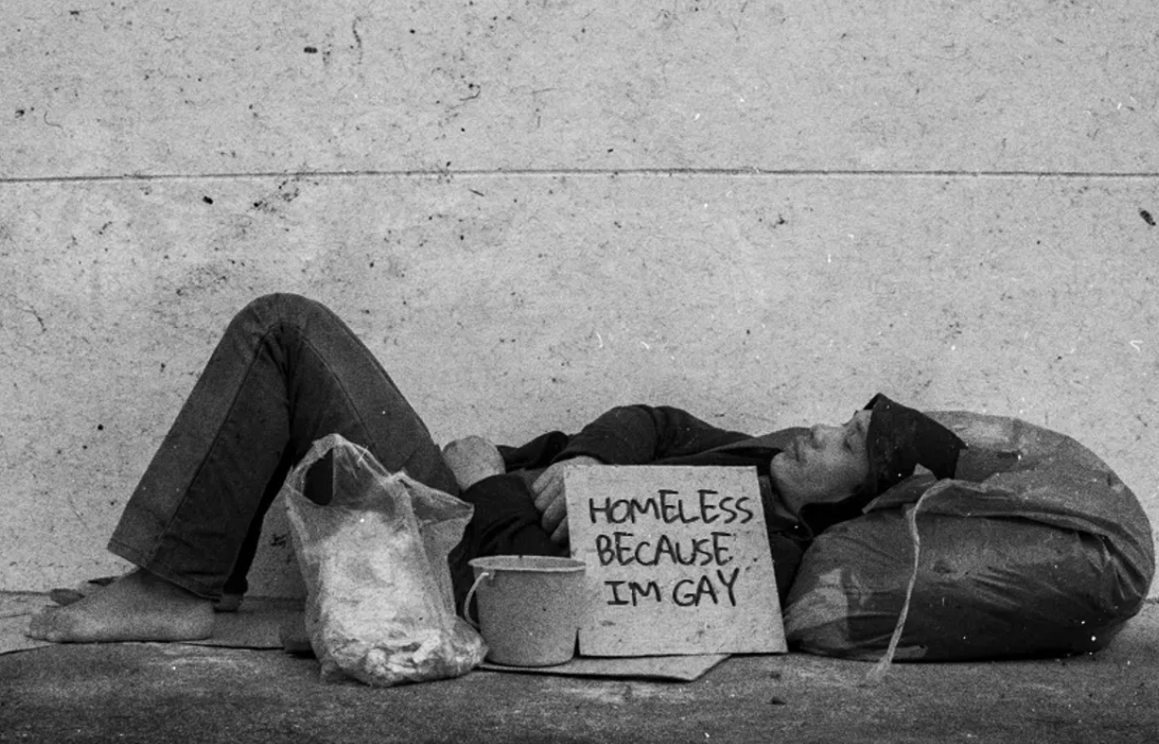
Discrimination of the Unsheltered
Anti-homeless ordinances and arrested people for acts of survival: sleeping in vehicles, asking for money, sharing food, and more.
In a 2014 survey, the National Coalition for the Homeless reported at 70.4% of homeless respondents felt that they had been discriminated against by private businesses based on housing status.
LGBTQ+ youth both in Massachusetts and nationally report being turned away from shelters.
They also report instances of homophobia and transphobia while in shelters.
Providing civil rights protections to people experiencing homelessness will reduce the barriers they face trying to exit homelessness for good.

Slide 10
Known Population Details: FOH, 2018

Slide 12
Theoretical Assumptions:
Housing First, Best Practice
Immediate access to permanent housing
Choice and self-determination
Recovery Support
Individualized support services
Community integration
= Important to address all areas to successfully improve housing stability over the long term.
= “Housing stability has been shown to support long-term recovery and prevent relapse from substance abuse and mental disorders (Kertesz, Horton, Friedmann, Saitz, & Samet, 2003, in SAMHSA 2015).

Slide 13
Trauma, Substance Abuse, and Homelessness

Slide 14
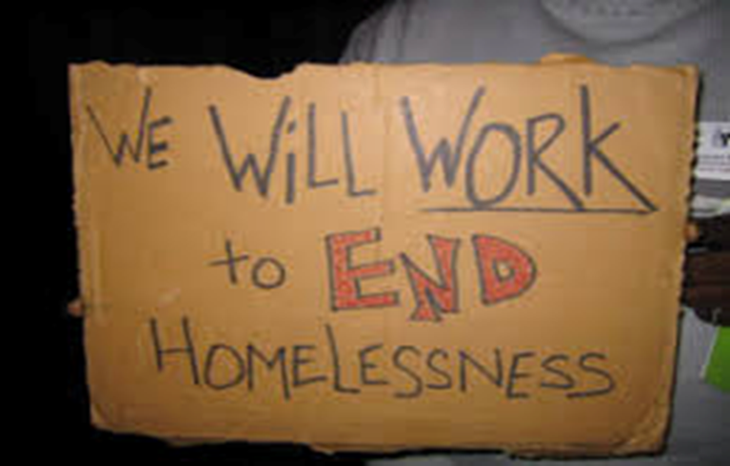
Trauma-Responsive Homelessness Intervention
Principles of Trauma Informed Care (TIC) (Fallot & Harris, 2009; Hopper et al., 2010; Olivet et al., 2010 in Levy & Johnson, 2018):
Safety
Trustworthiness and transparency
Peer Support
Collaboration
Empowerment
Voice and choice
TIC in homelessness: (Levy & Johnson, 2018)
An awareness of the nature and later expression of past trauma;
An emphasis on safety;
Creating opportunities to rebuild control; and,
Adoption of strengths-based approach.

Slide 15
There are 5 Western MA “Emergency” Shelters for Individuals
Friends of the Homeless, Worthington Street, Springfield (133 beds—flexible cap—behavior based—average 150 per night)
Grove Street Inn (ServiceNet), Northampton (20 beds-wait list-dry shelter)
Samaritan Inn, Westfield (30 beds--dry)
Greenfield Shelter (ServiceNet) (20 beds-dry)
Barton’s Crossing, Pittsfield, (ServiceNet) (14 beds)
Winter only:
Amherst Shelter, Craig’s Doors, (behavior based)
Cot Shelter, Northampton (ServiceNet)(dry)
Taylor Street, Springfield (Rescue Mission)

Slide 16
Clinical & Support Options, Homelessness and Housing Services
Worthington St. Campus:
Emergency Shelter
Case Management
Integrated Treatment Services
Health Services for the Homeless
3 Hot Meals, daily
Resource Center
110 Low Income Units

Slide 17
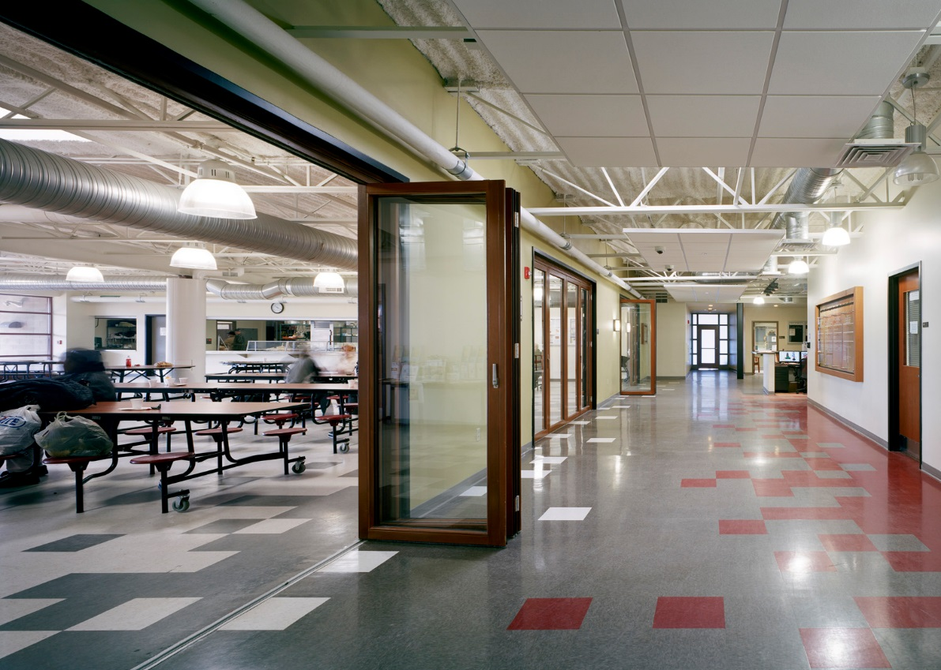
Resource Center: Home to case management, cafeteria, groups, and the medical and dental clinic.

Slide 18
Meal program, case management, medical, dental, SUD treatment

Slide 19
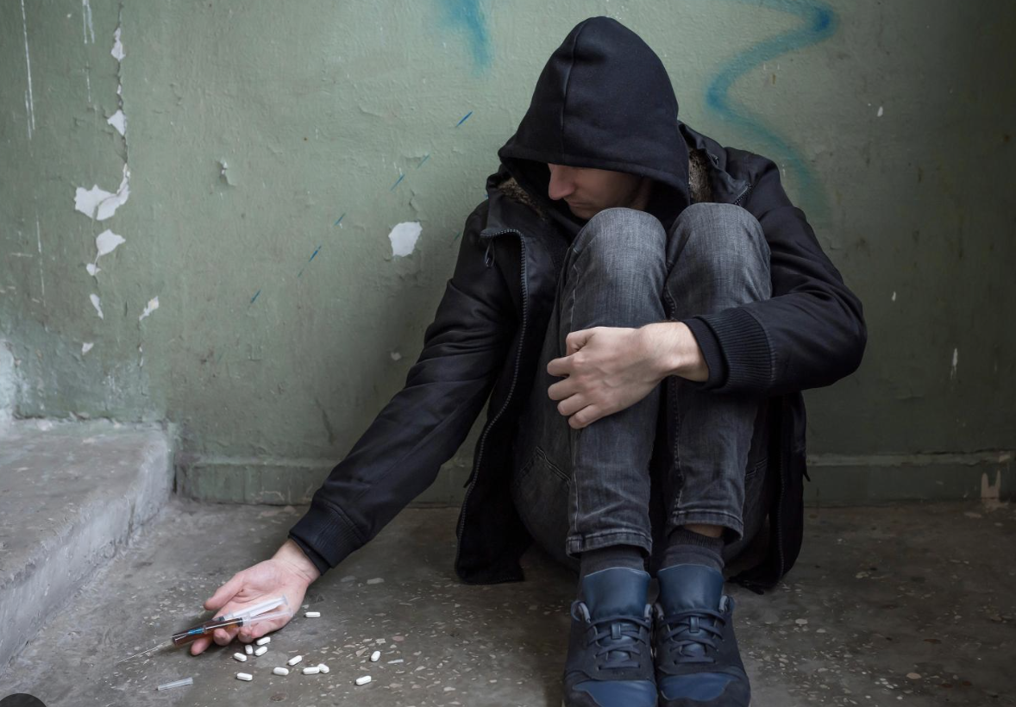
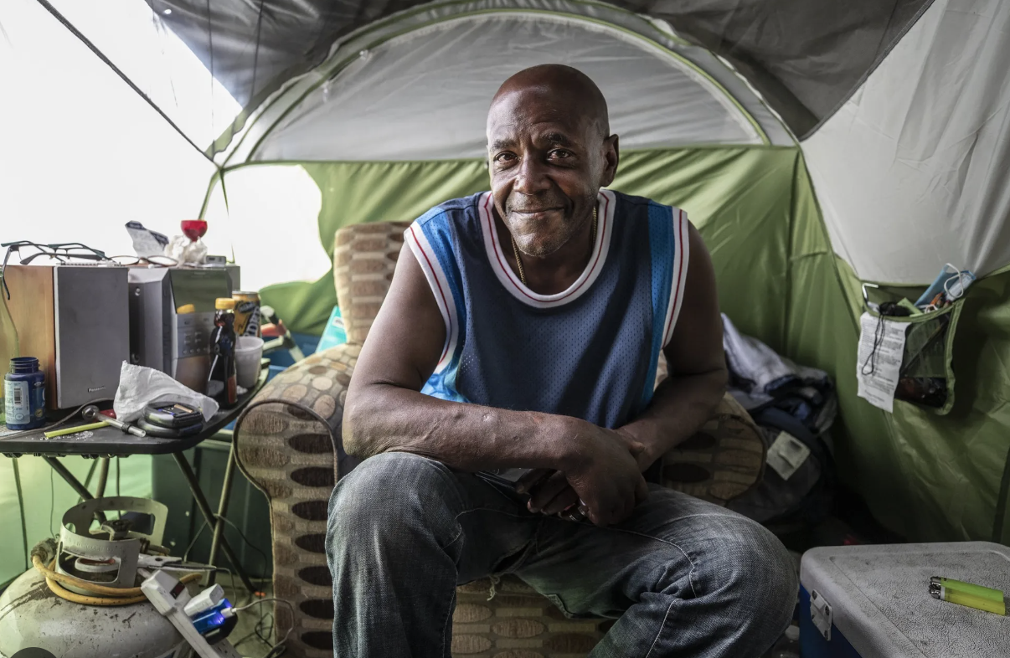
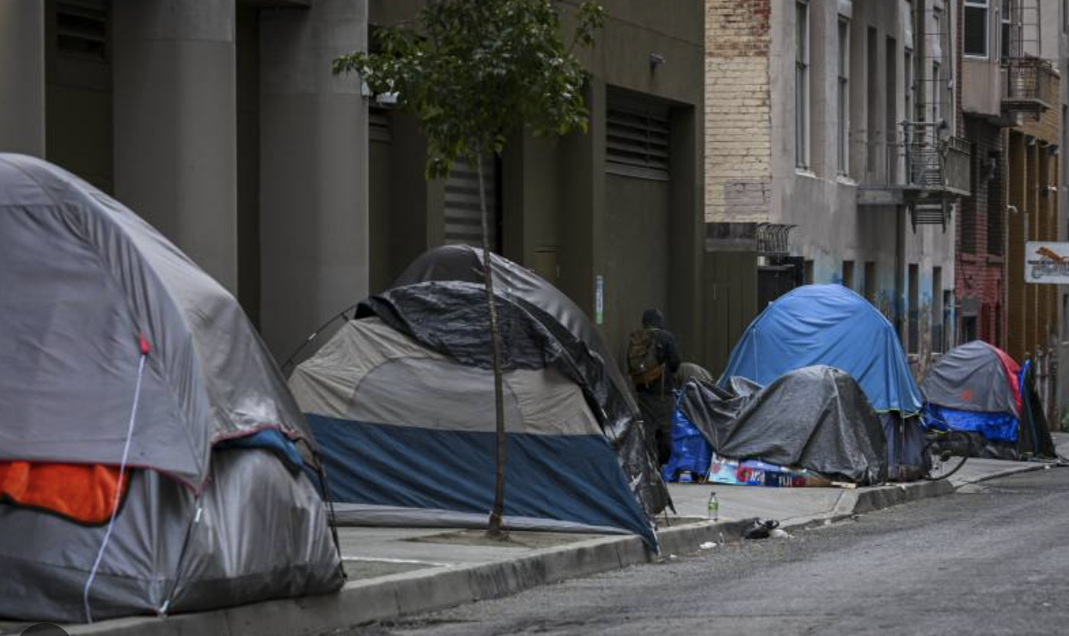
Shelter Refusal
Why would anyone refuse shelter?
Trauma, PTSD
Substance Use and lack of Harm-Reduction
Autonomy & Respect

Slide 20
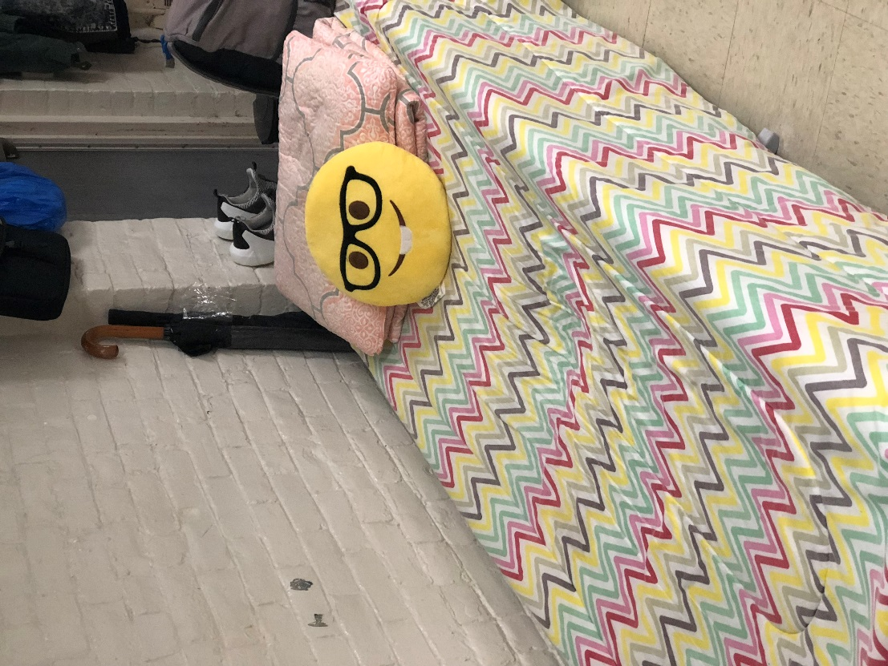
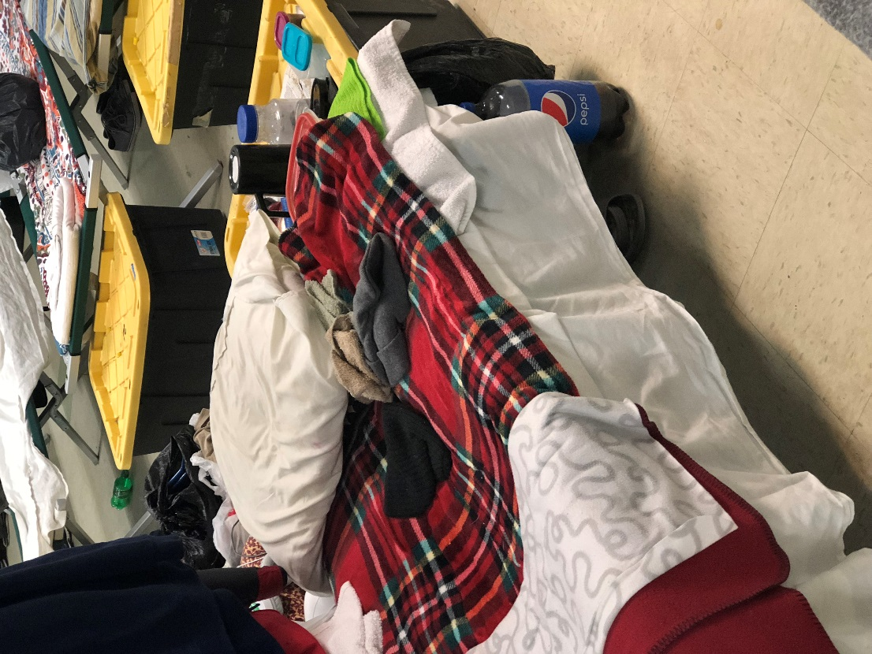
Emergency Shelter: “Describe your first night in shelter?”

Slide 21
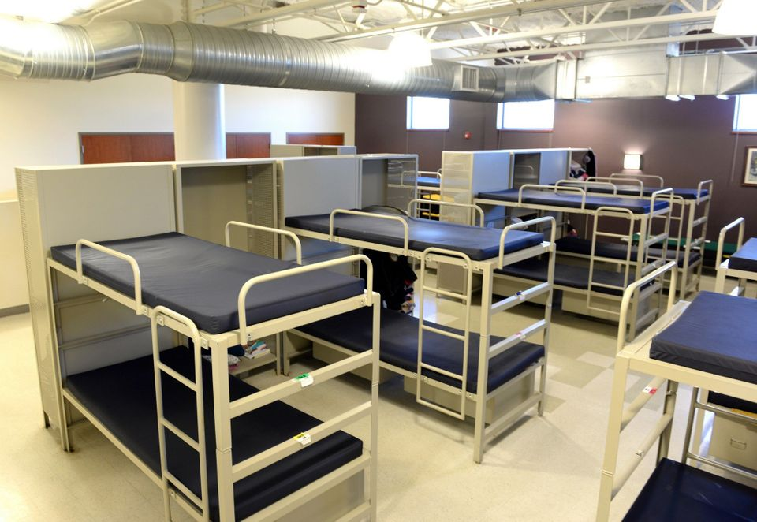

Slide 22
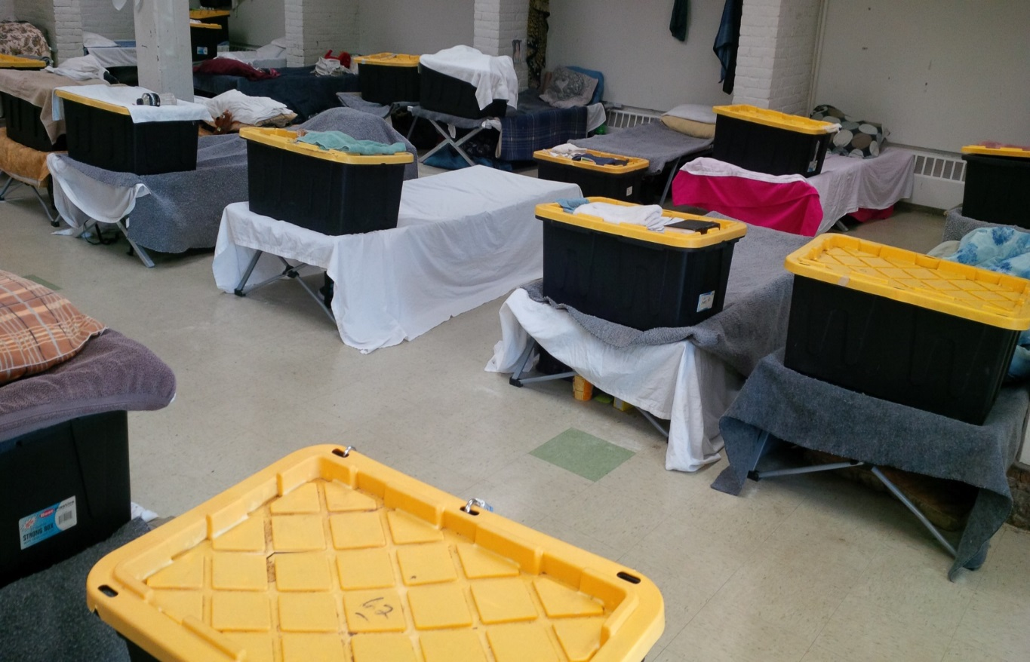
Beds, cots, and floors. Overstimulation, no privacy, in a community of traumatized and trauma. Listen in!

Slide 23
Common Mental Health Challenges:
Mood Disorders: Depression, Bipolar Disorders
Anxiety Disorders: Generalized Anxiety Disorder
Psychotic Disorders: Schizoaffective Disorder, Schizophrenia
Substance Use Disorders: Opioid Use, Alcohol Use, Cocaine Use, Cannabis Use
Trauma: Post-traumatic Stress Disorder, Acute Stress Disorder, Trauma of Chronic Poverty, Trauma of System Failures, Attachment Traumas, Trauma of Homelessness.

Slide 24
“Triple-Diagnosis” Population:
Mental or behavioral health challenges
+
Substance use challenges
+
Medical challenges

Slide 25
Unknown Population Demographics:
Top Reasons Causing Homelessness
Incidence of Trauma Histories
Incidence of Substance Use D/Os
Incidence of Triple Diagnoses
How reductions in MH, SUD, and Medical Impact Permanent Housing rates!

Slide 26
Integrated Treatment Services
Agencies, such as, Substance Abuse and Mental Health Services Administration (SAMHSA), delegate millions of federal dollars to non-profits for the integration of:
mental health
substance abuse
medical care, and
rapid housing search services for those experiencing homelessness.

Slide 27
Successful Path To Housing
The Team:
The Outcomes:
Case Manager
Housing Placement Specialists/Housing Navigator (CHD, FOH, Elliot Services)
Outreach Team
Community Support Providers
Recovery Support Navigators
Affiliate Mental Health
Higher Levels of Care
Affiliate SUD Tx Centers
Affiliate PCPs/Health Care for the Homeless
Case Managment
County chronically homelessness list.
Section 8, Food Stamps, etc.
Connection to Mental Health Support
Connection to SUD Tx, Recovery Coaching
Medical Care
Transportation
DCF, Probation, Court
Enduring supports

Slide 28
Important Engagement Philosophies
Harm reduction:
“Inherent in harm reduction is an understanding that it is not necessarily the drugs themselves that do the most damage to a user; the laws and systems of prohibition – which make drug procurement and possession illegal – are what hurt people the most” (Lupik,2017)
Self-determination:
“Allowing each person to determine for themselves the time, place, course, and method of therapeutic treatment chosen, if any” (Lupik, 2017).

Slide 29
Supporting Trauma And Mental Health Challenges:
Creating Safety
On-site and available 12 hours
OP and Psych, on site
Groups, on-site
Offering transportation
Evidenced-Based Practices:
Trauma-Informed Care (TIC)
Trauma-Responsive Interventions
Motivational Interviewing (MI)
Dialectical Behavioral Therapy Skills (DBT)
Recovery Management
Community Support and Recovery Supports
Improving Humanity, Autonomy, Safety

Slide 30
Supporting Those With Substance Use
Bearing witness
Engagement, relationship
Providing acceptance
Allowing anonymity
Building relationships with area providers
Crisis Teams
Harm reduction supports
Area fast-track to inpatient detox
Protocols around CSS-level after care
Staff education
Guest education
Part of founding board of opioid coalition
Responding to urges for cessation immediately
Narcan - responding to ODs, saving lives
Providing on-site SUD groups

Slide 31
Center for Human Development’s Behavioral Health Center (CBHC)
Laying the Groundwork for
Improved Community-Based Acute Care
C

Slide 32
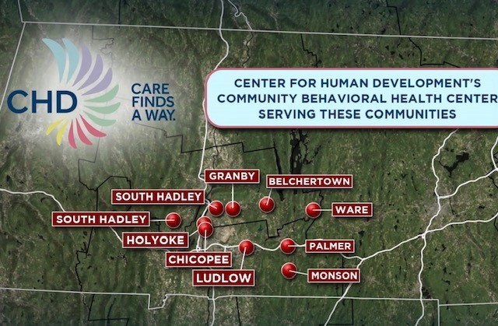
C

Slide 33
CBHCs: The Basics
Mass. EOHHS has designated providers across the state as Community Behavioral Health Centers.
Response to need for greater spectrum of acute care services, reduced emergency room boarding, and longer term reductions in higher levels of care
Meeting the need as the need emerges and supports the need along all levels of care.
M

Slide 34
In January 2023, Community Behavioral Health Centers (CBHCs) opened to serve as an entry point for timely, high-quality and evidence-based treatment for mental health conditions and substance use disorders.
Routine appointments
Urgent visits
24/7/365 community-based crisis intervention as an alternative to hospital emergency departments.
Enhanced access to nursing and psychiatry.
Ease of access to recovery and peer supports.
Flexible, person-centered treatment at any point of need.
M

Slide 35
Key Goals
Expanded access, including same-day access to assessment/referral and crisis/urgent treatment
Community-based crisis intervention integrated with full OP continuum of services
Evidence-based, goal-oriented, trauma-informed care
Focus on equity through culturally competent, accessible treatment
Significant new funding for CBHCs – with provider accountability for quality and results
C

Slide 36
Spectrum of Acuity
Treatment throughout the CBHC, larger CHD, and community partner continuum
Substance Use Services and MAT
Police Co-Response
Outpatient Therapy and Psychiatry
Urgent Outpatient
Crisis Intervention
Crisis Stabilization
Inpatient
School Interventions
Hospital ED Support
C

Slide 37
Spectrum of Acuity
Treatment throughout the CBHC, larger CHD, and community partner continuum
“I am struggling with substance use and need help.”
“I have had police interaction and they are helping me get immediate support.”
“I am stable and in insight-based therapy and psychiatry”
“I don’t feel great and I need help faster than my next OP appointment.”
“I need immediate help.”
“I need to be in a supportive, structured, 24-hour community setting.”
“I need to be in a supportive, structured, locked hospital setting.”
“I have had school staff intervention and they are helping me get immediate support.”
“I am getting checked out or admitted for life-threatening medical or psychiatric needs.”
C

Slide 38
GATEWAY CBHC is One Door
CBHCs are not just crisis.
One access point for wide variety of needs.
Not linear.
C

Slide 39
Helping the Helpers
Vicarious Trauma Trainings
Advocating for formalized debriefing
Narcan training
Recommendation for EAP services
Mindfulness Groups
Boundary setting, managing expectations

Slide 40
Brainstorm!
Self-Assessment:
Where are points of integration in your work?
Where is the integration, developmentally?
Levels of acceptance to change in community?
Where are there obstacles, and what are they?
What do the successes look like?

Slide 41
Trauma, Substance Abuse, Homelessness Work – What Keeps the Helpers Going?

Slide 42
Thank you!

